Slide 1
Input Device: Scanner

Slide 2
Scanner
In computing a scanner is a device that analyzes images, printed text, handwriting or an object and converts it to a digital image. Most scanners today are variations of the desktop (or flatbed) scanner. Hand-held scanners where the device is moved by hand were briefly popular but are now not used due to the difficulty of obtaining a high-quality image. Both these types of scanners use charge-coupled device (CCD) or Contact Image Sensor (CIS) as the image sensor whereas older drum scanners use a photomultiplier tube as the image sensor.

Slide 3
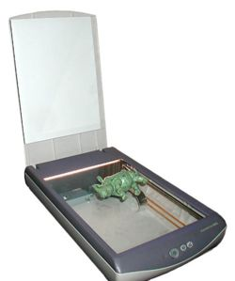
Scanner

Slide 4
Scanner
The basic principle of a scanner is to analyze an image and process it in some way. Image and text capture (optical character recognition or OCR) allow you to save information to a file on your computer. You can then alter or enhance the image print it out or use it on your Web page.

Slide 5
Types of Scanner
Drum Scanner
Flatbed Scanner
Hand scanners
Sheet-fed scanners
Digital camera scanners

Slide 6
Drum Scanner
Drum scanners are used by the publishing industry to capture incredibly detailed images. They use a technology called a photomultiplier tube (PMT). In PMT the document to be scanned is mounted on a glass cylinder. At the center of the cylinder is a sensor that splits light bounced from the document into three beams. Each beam is sent through a color filter into a photomultiplier tube where the light is changed into an electrical signal.

Slide 7
Drum Scanner (Continued)
Most modern color drum scanners use 3 matched PMTs which read red blue and green light respectively. Light from the original artwork is split into separate red blue and green beams in the optical bench of the scanner. The drum scanner gets its name from the large glass drum on which the original artwork is mounted for scanning: they usually take11"x17" documents but maximum size varies by manufacturer.

Slide 8
Drum Scanner (Continued)
One of the unique features of drum scanners is the ability to control sample area and aperture size independently. The sample size is the area that the scanner encoder reads to create an individual pixel. The aperture is the actual opening that allows light into the optical bench of the scanner. The ability to control aperture and sample size separately is particularly useful for smoothing film grain when scanning black-and white and color negative originals.
Notes:
Aperture-Hole

Slide 9
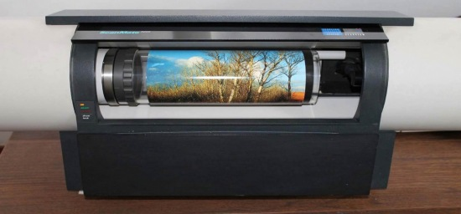
Drum Scanner (Continued)

Slide 10
Drum Scanner (Continued)
While drum scanners are capable of scanning both reflective and transmissive artwork a good-quality flatbed scanner can produce excellent scans from reflective artwork. As a result drum scanners are rarely used to scan prints now that high quality inexpensive flatbed scanners are readily available. Film however is where drum scanners continue to be the tool of choice for high-end applications. Because film can be wet-mounted to the scanner drum and because of the exceptional sensitivity of the PMTs drum scanners are capable of capturing very subtle details in film originals.

Slide 11
Drum Scanner (Continued)
Drum scanners remain in demand due to their capacity to produce scans that are superior in resolution color gradation and value structure. Also since drum scanners are capable of resolutions up to 12 000 PPI their use is generally recommended when a scanned image is going to be enlarged. The first image scanner ever developed was a drum scanner. It was built in 1957 at the US National Bureau of Standards by a team led by Russell Kirsch.

Slide 12
Flatbed Scanner
Flatbed scanners also called desktop scanners are the most versatile and commonly used scanners. A flatbed scanner is usually composed of a glass pane (or platen) under which there is a bright light (often xenon or cold cathode fluorescent) which illuminates the pane and a moving optical array whether CCD or CIS.

Slide 13
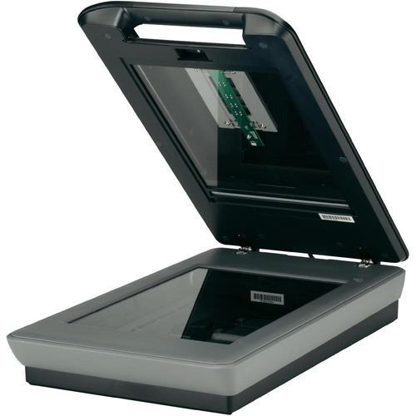
Flatbed Scanner (Continued)

Slide 14
Flatbed Scanner (Continued)
Color scanners typically contain three rows (arrays) of sensors with red green and blue filters. Images to be scanned are placed face down on the glass an opaque cover is lowered over it to exclude ambient light and the sensor array and light source move across the pane reading the entire area. An image is therefore visible to the charge-coupled device only because of the light it reflects. Transparent images do not work in this way and require special accessories that illuminate them from the upper side

Slide 15
Handheld scanners
Handheld scanners use the same basic technology as a flatbed scanner but rely on the user to move them instead of a motorized belt. This type of scanner typically does not provide good image quality. However it can be useful for quickly capturing text. Hand scanners are manual devices that are dragged across the surface of the image to be scanned.

Slide 16
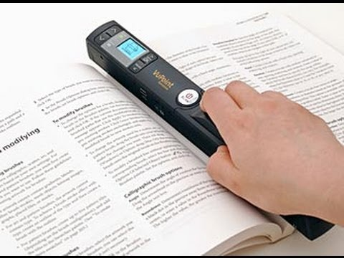
Handheld scanners(Continued)

Slide 17
Handheld scanners(Continued)
Scanning documents in this manner requires a steady hand as an uneven scanning rate would produce distorted images. They typically have a "start" button which is held by the user for the duration of the scan; some switches to set the optical resolution; and a roller which generates a clock pulse for synchronization with the computer. Most hand scanners were monochrome and produced light from an array of green LEDs to illuminate the image. A typical hand scanner also had a small window through which the document being scanned could be viewed.

Slide 18
Sheet-fed scanners
Sheet-fed scanners are similar to flatbed scanners except the document is moved and the scan head is immobile. A sheet-fed scanner looks a lot like a small portable printer.
Notes:
Immobile-Motionless

Slide 19
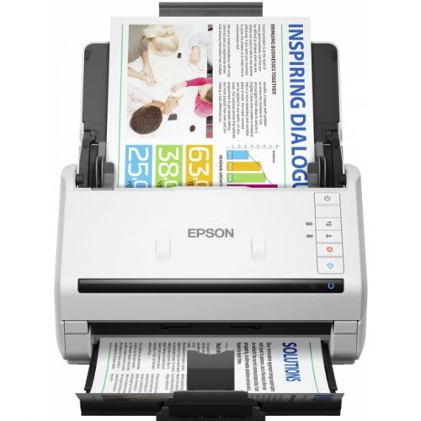
Sheet-fed scanners

Slide 20
Digital Camera Scanners
Digital camera scanners are based on the concept of reprographic cameras. Due to increasing resolution and new features such as anti-shake digital cameras have become an attractive alternative to regular scanners. While still containing disadvantages compared to traditional scanners digital cameras offer unmatched advantages in speed and portability.

Slide 21
Other Scanners
Another category of scanner is a rotary scanner used for high-speed document scanning. This is another kind of drum scanner but it uses a CCD array instead of a photomultiplier. Other types of scanners are planetary scanners which take photographs of books and documents and 3D scanners for producing three-dimensional models of objects but these types of scanner are considerably more expensive than other types of scanners

Slide 22
Anatomy of a Scanner
Parts of a typical flatbed scanner include:
Charge-coupled device (CCD) array | Filters
Mirrors | Stepper motor
Scan head | Stabilizer bar
Glass plate | Belt
Lamp | Power supply
Lens | Interface ports
Cover | Control circuitry

Slide 23
Anatomy of a Scanner (Continued)
The core component of the scanner is the CCD array. CCD is the most common technology for image capture in scanners. CCD is a collection of tiny light-sensitive diodes which convert photons (light) into electrons (electrical charge). These diodes are called photosites. In a nutshell each photosite is sensitive to light -- the brighter the light that hits a single photosite the greater the electrical charge that will accumulate at that site. The image of the document that you scan reaches the CCD array through a series of mirrors filters and lenses.

Slide 24
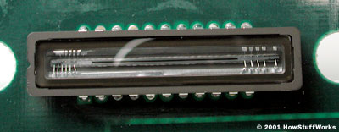
CCD array
Fig. Close-up of a CCD array

Slide 25
The Scanning Process
Here are the steps that a scanner goes through when it scans a document :
The document is placed on the glass plate and the cover is closed. The inside of the cover in most scanners is flat white although a few are black. The cover provides a uniform background that the scanner software can use as a reference point for determining the size of the document being scanned. Most flatbed scanners allow the cover to be removed for scanning a bulky object such as a page in a thick book.

Slide 26
Scanning Process (Continued)
A lamp is used to illuminate the document. The lamp in newer scanners is either a cold cathode fluorescent lamp (CCFL) or a xenon lamp while older scanners may have a standard fluorescent lamp.

Slide 27
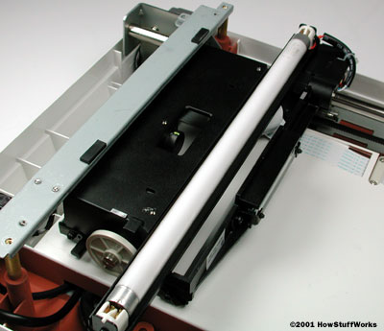
Scanning Process (Continued)
Fig. In the image above you can see the fluorescent lamp on top of the scan head.

Slide 28
Scanning Process (Continued)
The entire mechanism (mirrors lens filter and CCD array) make up the scan head. The scan head is moved slowly across the document by a belt that is attached to a stepper motor. The scan head is attached to a stabilizer bar to ensure that there is no wobble or deviation in the pass. Pass means that the scan head has completed a single complete scan of the document.

Slide 29
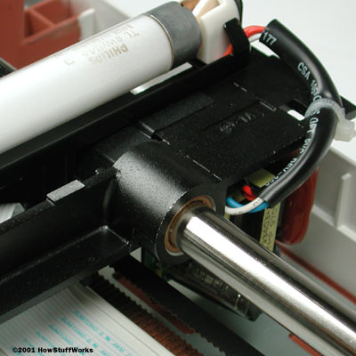
Scanning Process (Continued)
Fig. The stabilizer bar is very durable and tightly secured to the body of the scanner.

Slide 30
Scanning Process (Continued)
The image of the document is reflected by an angled mirror to another mirror. In some scanners there are only two mirrors while others use a three mirror approach. Each mirror is slightly curved to focus the image it reflects onto a smaller surface
The last mirror reflects the image onto a lens. The lens focuses the image through a filter on the CCD array

Slide 31
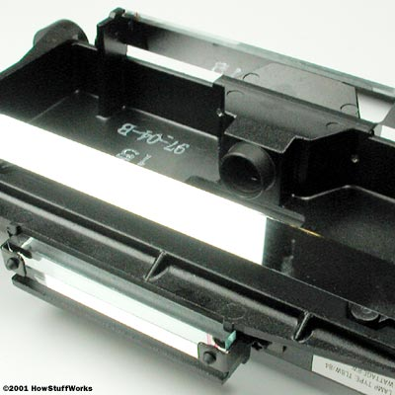
Scanning Process (Continued)
Fig. all three of the mirrors plus the lens assembly in the scan head.

Slide 32
Scanning Process (Continued)
The filter and lens arrangement vary based on the scanner. Some scanners use a three pass scanning method. Each pass uses a different color filter (red green or blue) between the lens and CCD array. After the three passes are completed the scanner software assembles the three filtered images into a single full-color image.

Slide 33
Scanning Process (Continued)
Most scanners today use the single pass method. The lens splits the image into three smaller versions of the original. Each smaller version passes through a color filter (either red green or blue) onto a discrete section of the CCD array. The scanner combines the data from the three parts of the CCD array into a single full-color image.

Slide 34
Scanning Process (Continued)
Another imaging array technology that has become popular in inexpensive flatbed scanners is contact image sensor (CIS). CIS replaces the CCD array mirrors filters lamp and lens with rows of red green and blue light emitting diodes (LEDs).

Slide 35
Scanning Process (Continued)
The image sensor mechanism consisting of 300 to 600 sensors spanning the width of the scan area is placed very close to the glass plate that the document rests upon. When the image is scanned the LEDs combine to provide white light. The illuminated image is then captured by the row of sensors. CIS scanners are cheaper lighter and thinner but do not provide the same level of quality and resolution found in most CCD scanners.

Slide 36
Summary of How Scanner works?
The image to be scanned is placed on top of the scanner’s glass plate
The computer sends instructions to the logic board about how far the motor is to run and how fast
The logic board instructions place the scanning unit into an appropriate position to begin scanning
The scanning unit moves across the image to be scanned at a speed designated by the logic board instruction
As the scanning unit moves across the image a light source shines on the image

Slide 37
Summary of How Scanner works? …
The light strikes the image reflects and is then reflected by a series of mirrors to the scanner lens
The light passes through the scanner lens and reaches the CCD sensors
CCD sensors measure the amount of light reflected through the image and converts the light to an analog voltage
The analog voltage is changed to digital values by an ADC – analog to digital converter
The digital signals from the CCDs are sent to the logic board and transmitted back to the computer

Slide 38
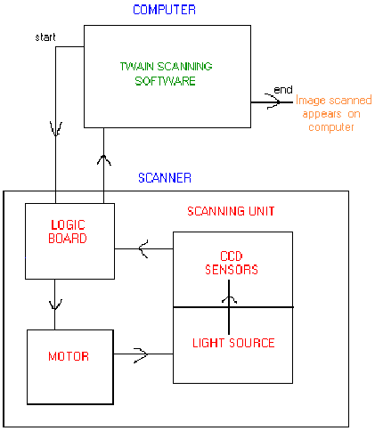
A Flow Chart of How a Scanner Works

Slide 39
Resolution and Interpolation
Scanners vary in resolution and sharpness. Most flatbed scanners have a true hardware resolution of at least 300x300 dots per inch (dpi). The scanner's dpi is determined by the number of sensors in a single row (x-direction sampling rate) of the CCD or CIS array by the precision of the stepper motor (y-direction sampling rate).

Slide 40
Resolution and Interpolation (Cont.)
For example if the resolution is 300x300 dpi and the scanner is capable of scanning a letter-sized document then the CCD has 2 550 sensors arranged in each horizontal row. A single-pass scanner would have three of these rows for a total of 7 650 sensors. The stepper motor in our example is able to move in increments equal to 1/300ths of an inch. Likewise a scanner with a resolution of 600x300 has a CCD array with 5 100 sensors in each horizontal row.

Slide 41
Resolution and Interpolation (Cont.)
Interpolation is a process that the scanning software uses to increase the perceived resolution of an image. It does this by creating extra pixels in between the ones actually scanned by the CCD array. These extra pixels are an average of the adjacent pixels. For example if the hardware resolution is 300x300 and the interpolated resolution is 600x300 then the software is adding a pixel between every one scanned by a CCD sensor in each row.

Slide 42
Output data
The scanned result is a non-compressed RGB image which can be transferred to a computer's memory. Some scanners compress and clean up the image using embedded firmware. Once on the computer the image can be processed with a raster graphics program (such as Photoshop or the GIMP) and saved on a storage device (such as a hard disk). In common use scanned pictures are stored on a computer's hard disk normally in image formats such as JPEG TIFF Bitmap and PNG. Some scanners can also be used to capture editable text so long as the text can be read by the computer in a discernable font. This process is called Optical Character Recognition (OCR).

